Slide 1

Model-Driven Software Engineering
Attila Balogh-Biró 2019

Slide 2
Course agenda
Introduction
Model-Driven Software (MDSE) engineering principles
MDSE use cases
Model-Driven Architecture (MDA)
Integrating MDSE into the SDLC
Introduction to modelling languages
UML basics

Slide 3
Course agenda
Overview of Enterprise Architect
Customizing the workspace
Repository Structure
Creating and managing models
Working Collaboratively
Version Control and baselines
Overview of Document Generation

Slide 4

Model-Driven Software Engineering

Slide 5
Introduction
The human mind inadvertently and continuously re-works reality by applying cognitive processes that alter the subjective perception of it
abstraction
Generalization
Classification
Aggregation
generalization, classification, and aggregation represent natural behaviors that the human mind
Notes:
Among the various cognitive processes that are applied, abstraction is one of the most prominent ones. In simple words,
abstraction consists of the capability of finding the commonality in many different observations and thus generating a mental representation of the reality which is at the same time able to:
generalize specific features of real objects (generalization);
• classify the objects into coherent clusters (classification); and
• aggregate objects into more complex ones (aggregation).
Abstraction is also widely applied in science and technology, where it is often referred to as modeling.
We can informally define a model as a simplified or partial representation of reality, defined in order to accomplish a task or to reach an agreement on a topic.
Therefore, by definition, a model will never describe reality in its entirety.

Slide 6
What are Models?
“A model is an abstraction of something for the purpose of understanding it before building it” (J. Rumbaugh, M. Blaha, W. Premerlani, F. Eddy, and W. Lorensen. Object-Oriented Modeling and Design. Prentice Hall, Englewood Cliffs, New Jersey, USA, 1991)

Slide 7
What are models?
models as sketches: models are used for communication purposes, only partial views of the system are specified
models as blueprints: models are used to provide a complete and detailed specification of the system
models as programs: models, instead of code, are used to develop the system.
Notes:
The need for relying on models for software development is based on four main facts.
1. Software artifacts are becoming more and more complex and therefore they need to be discussed at different abstraction levels depending on the profile of the involved stakeholders, phase of the development process, and objectives of the work.
2. Software is more and more pervasive in people’s life, and the expectation is that the need for new pieces of software or the evolution of existing ones will be continuously increasing.
3. The job market experiences a continuous shortage of software development skills with respect to job requests.
4. Software development is not a self-standing activity: it often imposes interactions with non-developers (e.g., customers, managers, business stakeholders, etc.) which need some mediation in the description of the technical aspects of development.

Slide 8
Purpose of models
reduction feature
mapping feature
descriptive purpose
prescriptive purpose
Notes:
Models are recognized to implement at least two roles by applying abstraction
reduction feature: the models only reflect a (relevant) selection of the original’s properties, so as to focus on the aspects of interest
mapping feature: the models are based on an original individual, which is taken as a prototype of a category of individual and is abstracted and generalized to a model
descriptive purposes (i.e., for describing the reality of a system or a context)
prescriptive purposes (i.e., for determining the scope and details at which to study a problem), or for defining how a system shall be implemented.

Slide 9
Purpose of models
Abstraction from certain aspects of the real world
Focus on certain aspects of the real world
Ability to analyze properties of the system using the model
Models are usually expressed in a modeling language with a well-defined syntax and semantics
Many different forms of analysis, depending on the model and the application of modeling

Slide 10
Modeling in software development
Software artifacts complexity
Software is more and more pervasive in people’s life
The job market experiences a continuous shortage of software development skills with respect to job requests.
Software development is not a self-standing activity
Notes:
The need for relying on models for software development is based on four main facts.
1. Software artifacts are becoming more and more complex and therefore they need to be discussed at different abstraction levels depending on the profile of the involved stakeholders, phase of the development process, and objectives of the work.
2. Software is more and more pervasive in people’s life, and the expectation is that the need for new pieces of software or the evolution of existing ones will be continuously increasing.
3. The job market experiences a continuous shortage of software development skills with respect to job requests.
4. Software development is not a self-standing activity: it often imposes interactions with non-developers (e.g., customers, managers, business stakeholders, etc.) which need some mediation in the description of the technical aspects of development.

Slide 11
Usage of Models in Software Engineering
Models as description of the domain of the system to be
Models as abstract representation of the system to be built
Models for documentation
Models as specification for testing
Notes:
Models as description of the domain of the system to be built – Model focuses on relevant aspects of the domain –Example: Class diagram of the domain Models as abstract representation of the system to be built – Model focuses on aspects that are relevant, leaves other aspects open –Example: Component diagram specifies components of a system to be built Models for documentation –Abstraction of models helps to understand the system faster –Example: Class diagram of the key entities in a system are explained in a document Models as specification for testing – Model focuses on important aspects of the system for testing

Slide 12
MDSE definition
MDSE can be defined as a methodology
Model Driven Software Development (MDSD) is a style of software development that considers itself as an alternative to the traditional style of programming
To use MDSD you need tools that support ProjectionalEditing
MDSD is surrounded by a terminological mess
Notes:
The approach centers itself on building models of a software system.
These models are typically made manifest through diagrammatic design notations - the UML is one option.
The idea is that you use these diagrams, to specify your system to a modeling tool and then you generate code in a conventional programming language.
MDSD is surrounded by a terminological mess.
One particular vision of MDSD is ModelDrivenArchitecture (MDA) which is an OMG initiative based on the UML. Many people in the MDSD community, however, don't think that MDA or UML is the right vision for MDSD.
For a long time I would hear people talking about Model Driven Development (MDD) as the general concept and MDA as the OMG's specific vision.
However the OMG has trademarks on several "Model Driven *" and "Model Based *" phrases - including MDD. As a consequence people have to be careful about what model driven phrase they use

Slide 13
MDSE definition more detailed
Model-Driven Software Engineering (MDSE) is a software engineering paradigm
Models are considered as primary artifacts from which parts of a software system can be automatically generated
Models are usually more abstract representations of the system to be built
MDSE can improve productivity and communication
MDSE requires technologies and tools in order to be successfully applied
Various terms and approaches to MDSE – Model-driven architecture, model-driven engineering, model-driven development,

Slide 14
MDSD aspects
Concepts
Notations
Process and rules
Tools
Notes:
Concepts: The components that build up the methodology, spanning from language artifacts to actors, and so on.
• Notations: The way in which concepts are represented, i.e., the languages used in the methodology.
• Process and rules: The activities that lead to the production of the final product, the rules for their coordination and control, and the assertions on desired properties (correctness, consistency, etc.) of the products or of the process.
• Tools: Applications that ease the execution of activities or their coordination by covering the production process and supporting the developer in using the notations.
Algorithms + Data Structures = Programs
In our new MDSE context, the simplest form of this equation would read as follows:
Models + Transformations = Software
Obviously, both, models and transformations need to be expressed in some notation, which in MDSE we call a modeling language (in the same way that in the Wirth equation, algorithms and data structures need to be defined in some programming language). Nevertheless, this is not yet enough. The equation does not tell us what kinds of models (and in which order, at what abstraction level, etc.) need to be defined depending on the kind of software we want to produce. That’s where the model-driven process of choice comes to play. Finally, we need an appropriate set of tools to make MDSE feasible in practice. As for programming, we need IDEs that let us define the models and transformations as well as compilers or interpreters to execute them and produce the final software artifacts.

Slide 15
Important Aspects of MDSE
In MDSE approaches, the use of models and model transformations is proposed
Models are expressed in UML, an extension of UML, or a domain-specific language
The syntax and semantics of models used in a MDSE approach has to be clearly defined
The software development process is changed when an MDSE approach is adopted

Slide 16
MDSE primary question
How to get from requirements to running code satisfying requirements and user expectations?
Models are used in many development processes
–requirements for the system (e.g. use case model)
–software architecture (e.g. component model)
–behavioral description (e.g. statechart)

Slide 17
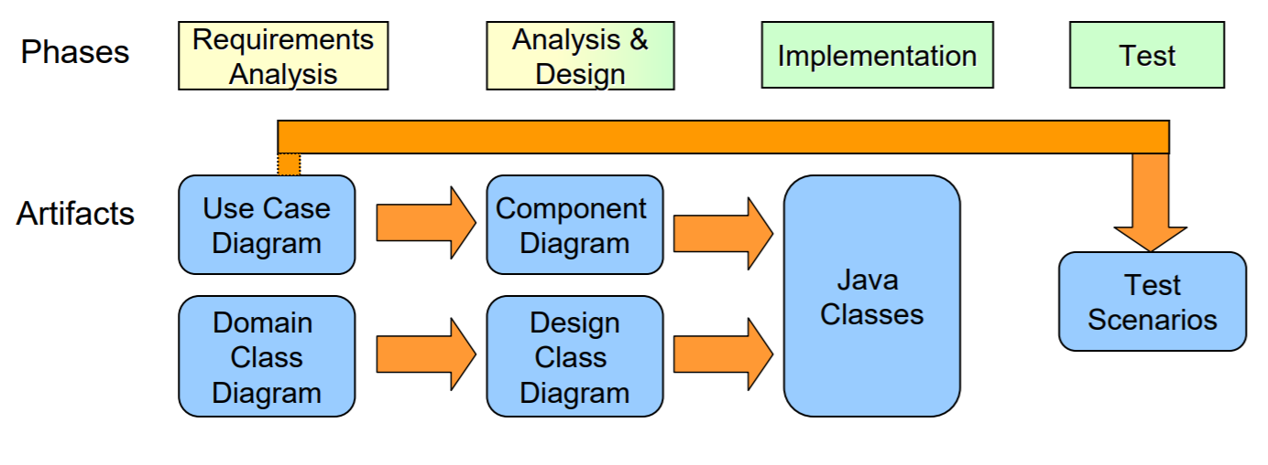
Usages of Models and Model Transformations in MDSE
Notes:
In each phase, different models are constructed
In each phase, we reuse parts of models as input for other models
– Test scenarios are partially derived from Use Case Diagrams – Design Class Diagram may reuse parts of Domain Class Diagram MDSE focuses on automatically generating parts of models or code from other models

Slide 18
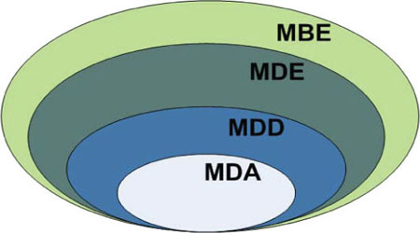
MBE vs MDE vs MDD vs MDA
Notes:
Model-Driven Development (MDD) is a development paradigm that uses models as the primary artifact of the development process. Usually, in MDD the implementation is (semi)automatically generated from the models.
Model-driven Architecture (MDA) is the particular vision of MDD proposed by the Object Management Group (OMG) and thus relies on the use of OMG standards. Therefore, MDA can be regarded as a subset of MDD, where the modeling and transformation languages are standardized by OMG.
On the other hand, MDE would be a superset of MDD because, as the E in MDE suggests, MDE goes beyond of the pure development activities and encompasses other model-based tasks of a complete software engineering process (e.g., the model-based evolution of the system or the model-driven reverse engineering of a legacy system).
Finally, we use “model-based engineering” (or “model-based development”) to refer to a softer version of MDE. That is, the MBE process is a process in which software models play an important role although they are not necessarily the key artifacts of the development (i.e., they do NOT “drive” the process as in MDE). An example would be a development process where, in the analysis phase, designers specify the domain models of the system but then these models are directly handed out to the programmers as blueprints to manually write the code (no automatic code-generation involved and no explicit definition of any platform-specific model). In this process, models still play an important role but are not the central artifacts of the development process and may be less complete (i.e., they can be used more as blueprints or sketches of the system) than those in a MDD approach. MBE is a superset of MDE. All model-driven processes are model-based, but not the other way round.
MDE does not focus on iterative model refinement by transformations, no intermediate models are created
Transformations are primarily used for translating models into code
A PIM model contains all necessary details to be translated into code which is then platform specific
Roundtrip engineering is avoided, design changes have to be made to the model Focus on software architecture

Slide 19
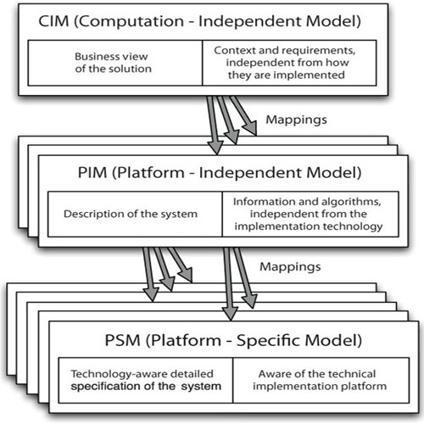
MDA Concept Overview
Notes:
Computation Independent Model (CIM) defines domain vocabulary
Platform Independent Model (PIM) captures domain related specifications
PIM does not contain platform details, independent of a platform Platform Specific Model (PSM) captures specifications with platform details For expressing PIM and PSM, domain-specific languages are used – UML profiles and other techniques for defining DSLs Model transformations transform PIMs into PSMs
Computation-Independent Model (CIM): The most abstract modeling level, which represents the context, requirements, and purpose of the solution without any binding to computational implications. It presents exactly what the solution is expected to do, but hides all the IT-related specifications, to remain independent of if and how a system will be (or currently is) implemented. The CIM is often referred to as a business model or domain model because it uses a vocabulary that is familiar to the subject matter experts (S
Platform-Independent Model (PIM): The level that describes the behavior and structure of the application, regardless of the implementation platform. Notice that the PIM is only for the part of the CIM that will be solved using a software-based solution and that refines it in terms of requirements for a software system
Platform-Specific Model (PSM): Even if it is not executed itself, this model must contain all required information regarding the behavior and structure of an application on a specific platform that developers may use to implement the executable code.

Slide 20
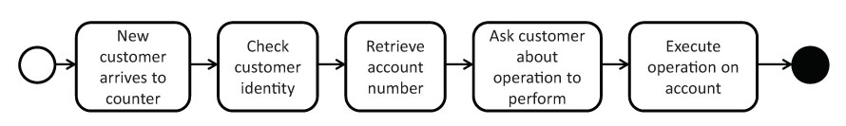
CIM
Notes:
A concrete example of the three levels can be the following: a firm wants to implement an invoicing process.
At the CIM level (Figure 4.2) the process is defined as a business process model listing the set of tasks to be performed and their dependencies

Slide 21
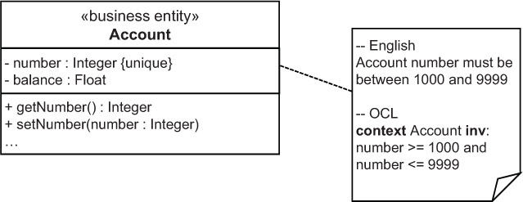
PIM
Notes:
The PIM level will describe that the software application will do some parts of the job,
in terms of information and behavior models (the access to a database and email sending could be fully automated, but shipping a signed paper invoice requires a clerk to mail the printed letter). Within this level, for instance, the details associated to a system implementation of the process must be detailed

Slide 22
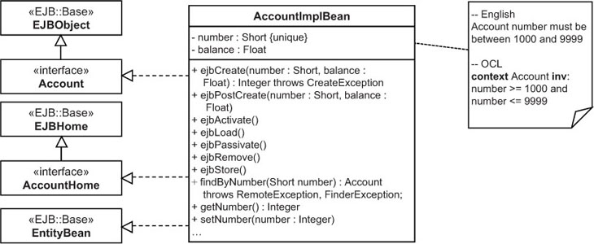
PSM
Notes:
Finally, at the PSM level, the implementation platform (whose description should be defined separately) for the process is selected and a set of precise descriptions of the technical details associated with that platform, including all the details regarding the invocations of the platform specific APIs and so on, will be provided within the models
Computation Independent Model (CIM) defines domain vocabulary
Platform Independent Model (PIM) captures domain related specifications
PIM does not contain platform details, independent of a platform
Platform Specific Model (PSM) captures specifications with platform details
For expressing PIM and PSM, domain-specific languages are used – UML profiles and other techniques for defining DSLs

Slide 23
Domain Driven Design
Domain-driven design (DDD) is an approach to software development based on two main principles
The primary focus of a software project should be the domain itself and not the technical details.
Complex domain designs should be based on a model
MDE can be regarded as a framework that provides the techniques to put DDD in practice
https://dddcommunity.org
Notes:
As such, DDD emphasizes the importance of an appropriate and effective representation of the problem domain of the system-to-be. For this purpose, DDD provides an extensive set of design practices and techniques aimed at helping software developers and domain experts to share and represent with models their knowledge of the domain.
Clearly, DDD shares many aspects with MDE. Both argue the need of using models to represent the knowledge of the domain and the importance of first focusing on platform independent aspects (using the MDA terminology) during the development process. In this sense, MDE can be regarded as a framework that provides the techniques to put DDD in practice (to model the domain, create DSLs that facilitate the communication between domain experts and developers if needed, etc.).

Slide 24
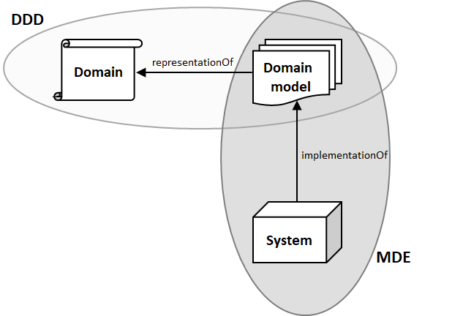
Domain Driven Design
Notes:
The single most important concept in DDD is to focus on the problem domain.
To put technology obsession to the side and concentrate primarily on modelling the problem you're trying to solve.
So put ajax, ORMs, databases, frameworks etc. into the background and instead make sure you have a complete, accurate model of the problem first and foremost. (Of course you still need the architectural components - but they're explicitly subservient to the model). DDD calls this "Ubiquitous Language" - a model expressed in terms domain experts and developers alike use and understand. A model where the names of classes, methods etc. are taken from the problem domain.
DDD doesn't mandate /how/ you capture that model, although the book implies using an OO language to do so.
MDA shares that same notion of modelling the problem domain first and foremost (the PIM, Platform-Independent Model). As opposed to DDD, it recommends creating that model with UML. But the intent is the same: understand the problem domain without tainting it with (software) architectural concerns.
MDA's PSM (Platform-Specific Model) is somewhat analogous to applying the architectural patterns in DDD (e.g. aggregate, repository, etc.). Again - while different in specifics - both aim to solve the problem of converting a 'pure' problem domain model into a full software system.

Slide 25
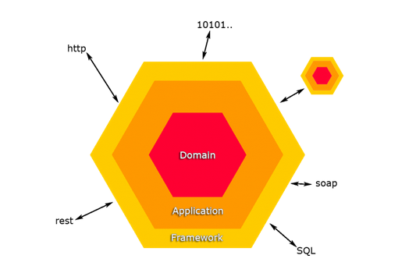
Hexagonal architecture

Slide 26
GENERAL-PURPOSE MODELING: UML
UML is a full-fledged language suite
UML is just a modeling language, and does not enforce any particular development method

Slide 27
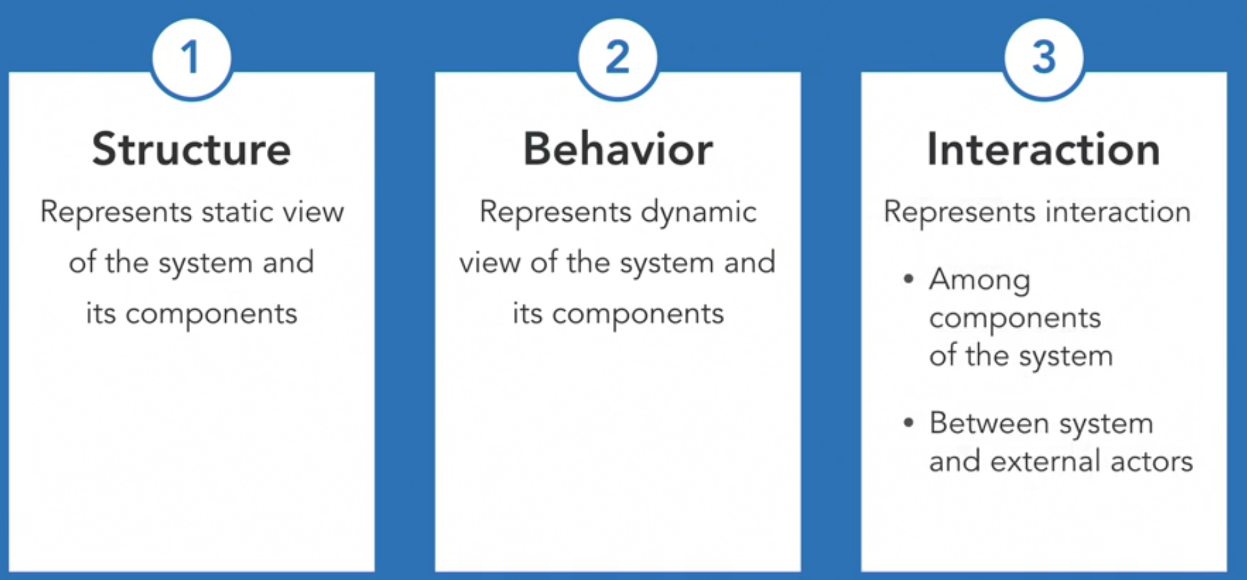
UML DIAGRAM TYPES

Slide 28
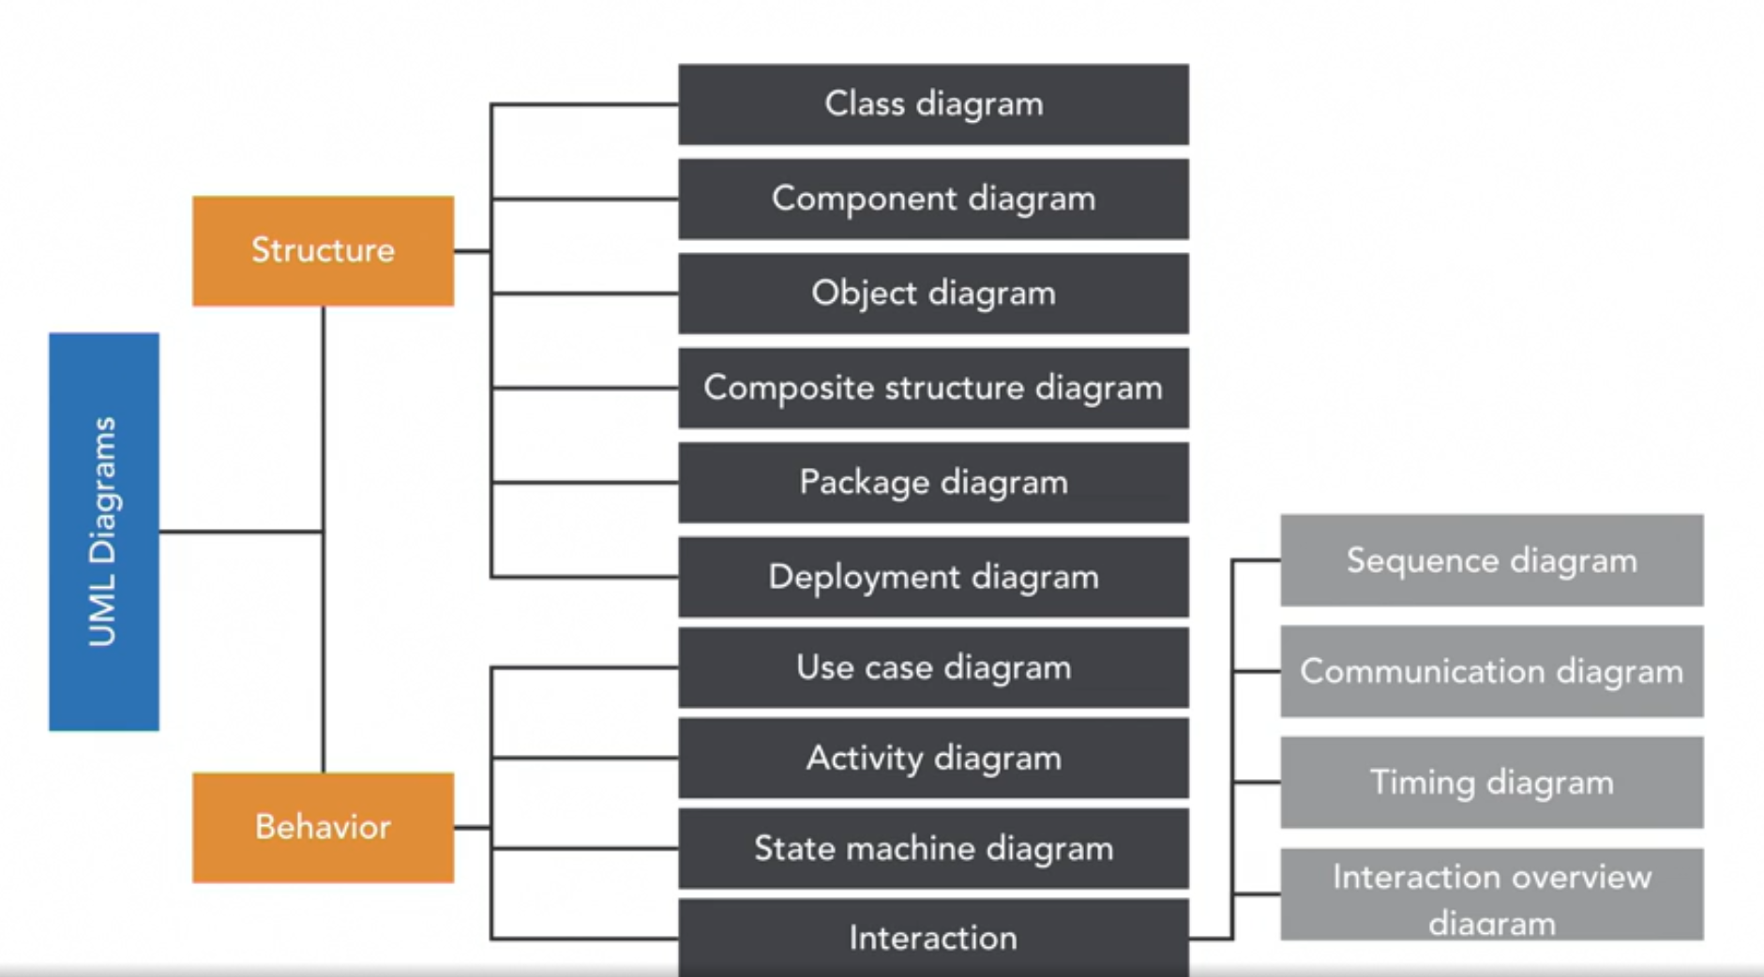
UML taxonomy
Notes:
hows the taxonomy of UML diagrams: 7 different diagrams can be used for describing the static (structural) aspects of the system, while other
7 diagrams can be used for describing the dynamic aspects. As shown in Figure 6.3, some of these diagrams describe characteristics of classes (i.e., abstract concepts), while others are used for describing features and behavior of individual items (i.e., instances). Some diagrams can be used for describing both levels.
1. Component diagram: Describes how a software system is split up into components and shows the dependencies among these components. A component in UML is defined as a distributable piece of implementation of a system, including software code (source, binary, or executable) but also other kinds of information. A component can be thought of as an implementation of a subsystem. Figure 6.5 shows an example of UML component diagram, where two components interact by exposing an interface and declaring a dependency on it, respectively.
2. Package diagram: Describes how a system is split up into logical groupings, called packages in UML parlance, by showing the dependencies among these groupings.
3. Deployment diagram: Describes the way in which the software artifacts are deployed on the hardware used in system implementations.
Use case diagram: Describes the functionality provided by a system in terms of actors external to the system; their goals in using the system, represented as use cases, and any dependencies among those use cases. This diagram is very useful for understanding the borders of the system to be implemented and for clarifying the usage scenarios. Specially relevant in the requirement specification phase and early design phase of the software development process.
• Activity diagram: Describes the step-by-step workflows of activities to be performed in a system for reaching a specific goal. An activity diagram shows the overall flow of data and control for performing the task, through an oriented graph where nodes represent the activities. Figure 6.6 shows an example of activity diagram, describing the actions to undertake depending on the status of the Shipping of a good.
• State machine diagram (or statechart): Describes the states and state transitions of the system, of a subsystem, or of one specific object. In general, state machines are suitable for describing event-driven, discrete behavior, but are inappropriate for modeling continuous behavior. The example in Figure 6.7 shows the states of a good with respect to the shipping and invoicing aspects, and the transitions that lead from one state to another. Notice that transitions may have associated conditions (e.g., whether the item is the last of the shipment or not). Notice also that in statecharts the nodes represent states (while in activity diagrams they represented actions).
• Interaction diagrams: A subset of behavior diagrams, emphasize the flow of control and data among the elements of the system. They comprise the following

Slide 29
Important considerations
Model selectively
Model collaboratively
Model smartly
Notes:
While there are so many types of diagrams, and their notations and complexity can get very intricate, it is important to consider a few tips.
First, you should model selectively. Remember that you're modeling to analyze, communicate, test, and document. Modeling is just a means to an end and not the end in itself.
So, you should selectively identify which types of diagrams you really need to create, and you do not and should not draw all 13 diagrams as it is just an overkill.
Second, model collaboratively. Models are thinking and communication tools. Create them and share them with your team to have a common understanding and agreement.
Third, model smartly.
Models are knowledge assets and with the entire team invest its time and expertise.
Keeping them handy and updated for future reference as your software design evolves is a great way to benefit from that investment.
Having said that, it is easy to lose ourselves in the minutia of various diagrams.
Do not spend too much time making them look perfect and pretty.
Start on a white board or a piece of paper and keep it rough and fluid. F
ocus on what you are modeling and not the model itself.
Once you have some basic semblance of the model, take a pick and go ahead with its implementation.
As you will go through iterations of design and implementation, your design will begin to solidify and that rough sketch will begin to stabilize.
That then will be a good time to use a tool to capture the final design for future reference. But which tool? Well, that is what we will discuss next.

Slide 30
CASE tools
Computer-aided software engineering tools help in various tasks through the sdlc
Key features: modeling, code generation, reverse engineering, analyzing code complexity etc.

Slide 31
Use case diagrams
Capture high-level functionality of the system using notation for actors, use cases and relationships among them
Drawn by business analysts to depict the summary all use cases in the system

Slide 32
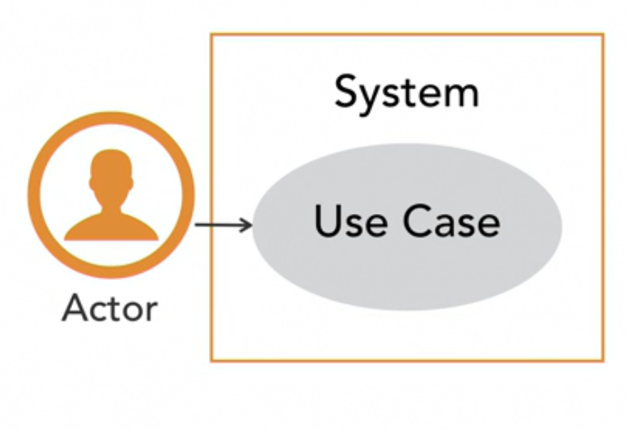
Use case diagrams
Notes:
Use case diagrams are a precursor to use case specifications that capture the overall functionality of a system at a very high level using notations for actors, use cases, and relationships among them. They are often used as a summary of all use cases in a system, showing which use cases have been identified and documented elsewhere in the detailed use case specifications.
There are four elements in a use case diagram. Use cases, the system for which the use cases have been identified, the actors, and associations among all these elements.
Let us first take the use case element. The notation for a use case is a bubble with a use case title. A use case title is a combination of a verb and a noun that captures what the user wants to do with the system. A use case may have associations with other actors, as well as use cases.

Slide 33
Activity diagram
Used for workflow and process modeling
Similar to flowcharts but with parallel behaviour and multiple actors
Often drawn by business analysits, developers to capture their requirements understaning in case of complex processes
Notes:
Activity diagram is a behavioral diagram that captures the workflow or the process model of a system
If you have learned any kind of flowcharting before, you will find activity diagrams to be very intuitive and easy to draw and understand
To add to its simplicity, activity diagram is quite powerful in its ability to capture parallel tracks in a process, as well as multiple actors involved in a process.

Slide 34
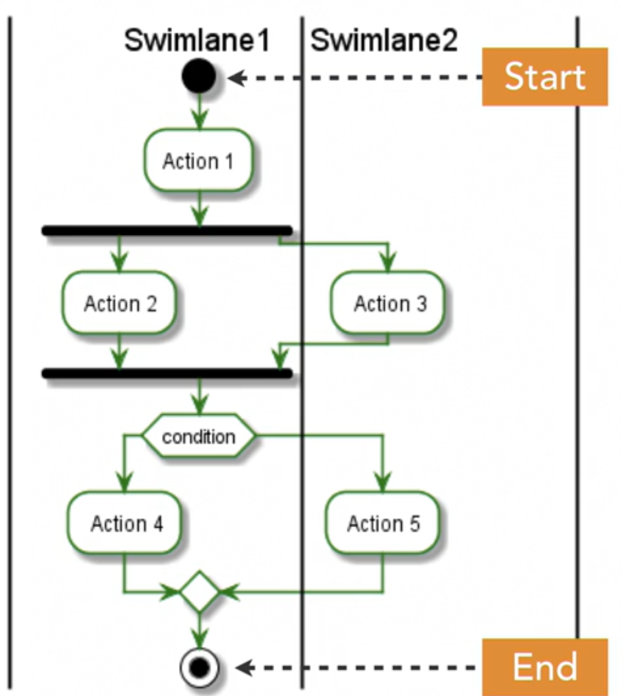
Activity diagram example

Slide 35
Class diagrams
Used to model the type of objects and relationships among them
One of the most commonly used diagram type in UML
Drawn by developers as part of design activity

Slide 36
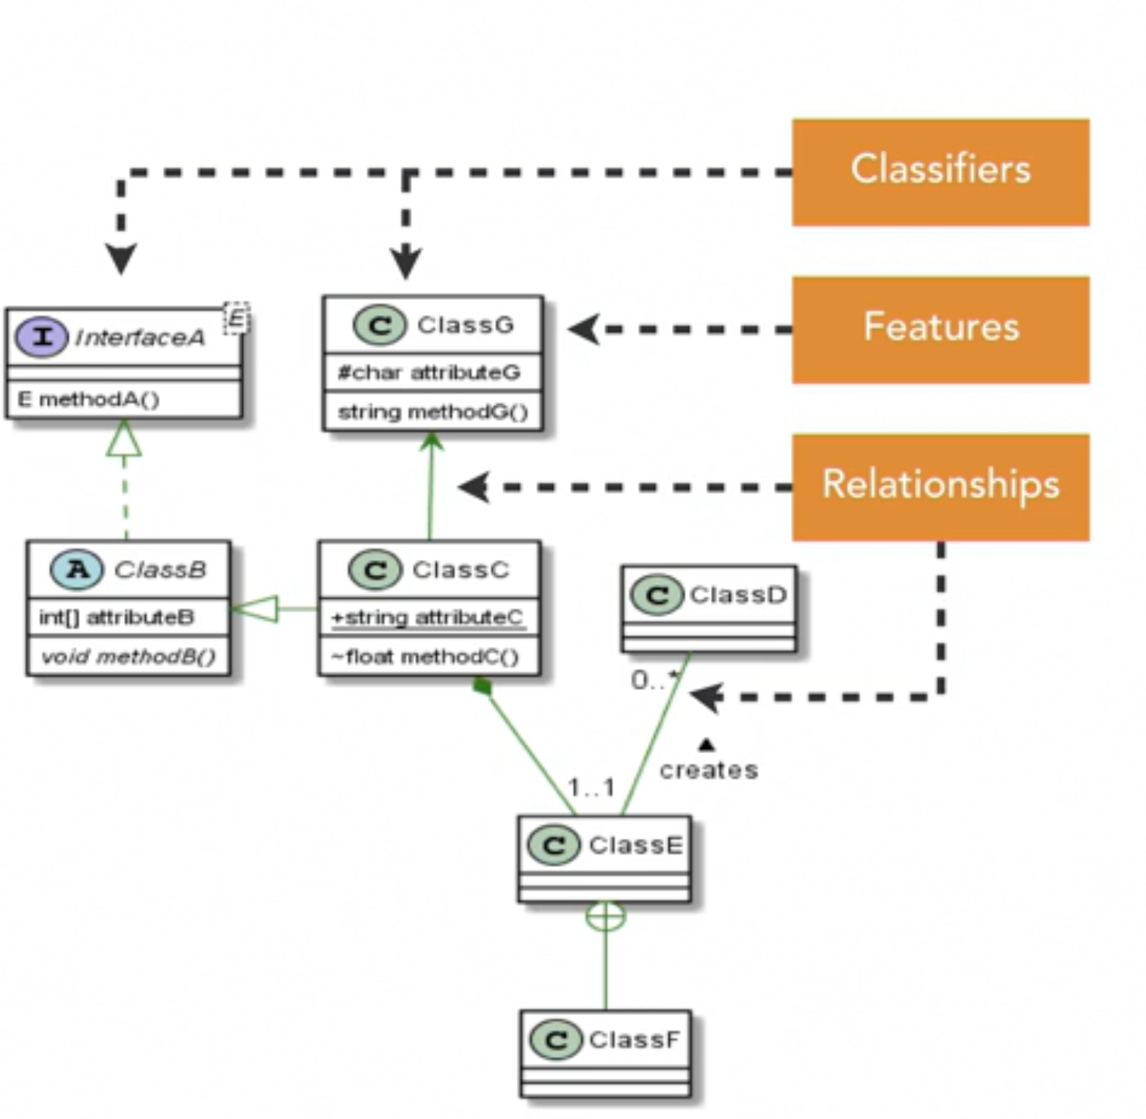
Class diagram example
Notes:
The key elements in class diagrams can be divided into three groups: classifiers, features, and relationships. Classifiers represent the types of entities in your system, features represent the structural and behavioral characteristics of these entities, and relationships depict how these entities are related to each other. Think of a classifier as a super type of things, such as abstract or concrete classes, interfaces, enumerations, generic classes, and so on. The technical definition is that classifier is an abstract metaclass. All classifiers are denoted as a box with three compartments, with a name in the top compartment. The bottom two compartments are for listing the features of the classifier. Features provide the structural and behavioral characteristics of classifiers. Structural features are nothing but the properties, or attributes, they are listed in the middle component of the classifier notation, and behavioral features are the operations, or methods, that go in the bottom compartment of the classifier box. Relationships bring all classifiers together to make the system work. For example, relationships show classes depending on each other, inheriting from each other, or implementing interfaces or abstract classes. Such relationships are grouped in three categories: associations, generalizations, and dependencies. Having seen the basic definitions of classifiers, features, and relationships, the question is, where do they come from? How do we identify them for a system? One very common source to identify these elements is the use case specification. Let us take a use case from an event scheduling system in which an Event-organizer in some organization wants to organize an event, and for that, she wants to book at venue. The system is supposed to offer the functionality of booking a venue for an event, which makes a use case as Book event-venue. In its basic scenario, the Event-organizer submits a request to book a venue. The request reaches a Venue-caretaker and a Parking-manager. The Venue-caretaker looks at various details of the request and approves if everything seem okay. Similarly, the Parking-manager also approves a request. After which, the Event-organizer confirms a venue booking. To derive a class diagram from this specification, the first step is to identify all nouns, as they represent potential candidates for classifiers. They are the entities that are going to be part of the system. So, here, I have identified seven of them. Note that I have users' roles, such as Event-organizer, and things that they work on, such as request or venue, in my list. Next, identify attributes of these classifiers. From this text, we can identify attributes for just three classifiers: request, event, and venue. When you carry out the same analysis for some other use cases, say, post an event or register for an event, then more attributes will emerge, which you can add to this list. Finally, identify the verbs, which indicate some kind of relationship among these classifiers. These relationships model the behavioral features of the classifiers. Having identified these key elements, now we can look at UML notations to create the first cut of a class diagram.

Slide 37
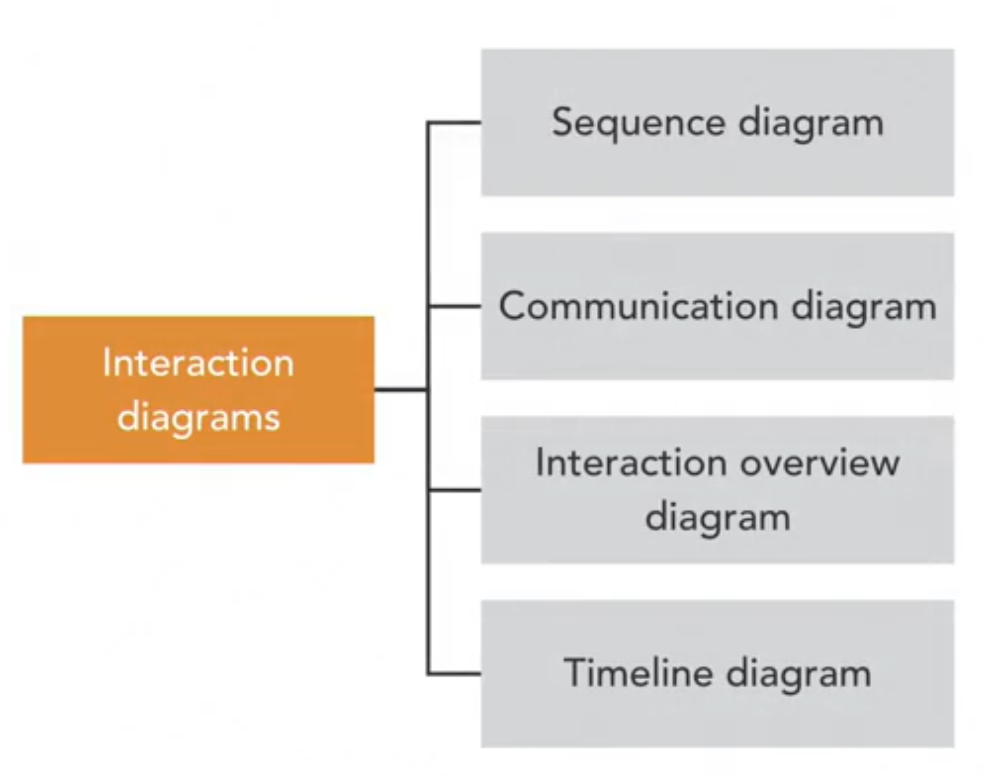
Interaction diagrams
Notes:
Interaction diagrams model the dynamic behavior of a system, focusing on interaction among the entities within a system.
There are four kinds of interaction diagrams, and I will discuss sequence and communication diagrams in this lesson.
Sequence diagrams are not only one of the most widely-used interaction diagrams, but also one of the most popular UML diagrams as well.
They capture the dynamic view of the system in terms of the sequence of interaction among its entities.
They help capture the communication among classes, and through that, help us identify the behavior that we need to implement in the code.

Slide 38
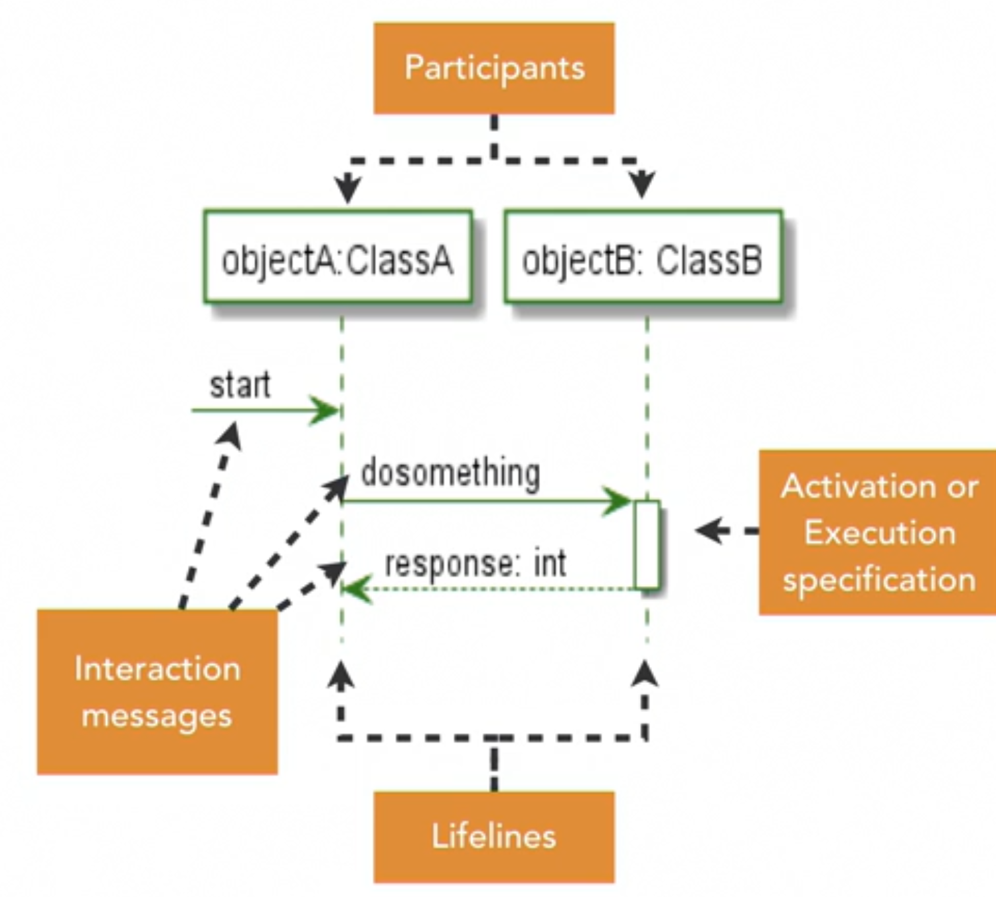
Sequence diagram
Notes:
Since interaction is a dynamic behavior, which occurs when the system is in execution mode, the participants are essentially live objects. So, the name is that of an object with an optional class name separated by a colon. The lifelines go from top to bottom, showing the flow of time when the object is alive. All messages going to a lifeline mean a message to the participant attached to that lifeline. Messages that ask the participant to do something are shown with a solid arrow, whereas a participant's response to a message is shown as a dotted arrow. The sequence diagram shown here models an interaction between two objects, objectA of type ClassA and objectB of type ClassB. First, objectA receives a message from somewhere to start. This kind of message coming from an unknown entity is also called as a found message, in the sense of lost and found. There are other kinds of messages in a system not in the scope of our discussion here that are sometimes lost because no object responds to them. Well, this one is found by objectA, which triggers this interaction. Then objectA sends a message to objectB to do something, and then objectB responds with a value of type int. An activation bar, also called as execution specification, is an optional notation indicating that the objectB is alive in memory, waiting for the interaction to be completed. It can be interpreted as the object's method being on stack for the duration of the activation bar. Making sequence diagrams requires knowing who the participants are and what kind of interaction they're having. How do we get that? Well, this is where the iterative approach becomes very useful.

Slide 39
Design practices
Pattern-based design: A set of very well-known design patterns, defined by the so-called Gang of Four
Using several integrated and orthogonal models together
Modeling at different levels of detail
Extensibility
Notes:
Pattern-based design: A set of very well-known design patterns, defined by the so-called Gang of Four, is available
Using several integrated and orthogonal models together: UML comprises a suite of diagrams that share some symbols and allow cross-referencing between modeling artifacts.
• Modeling at different levels of detail: UML allows eliding details in diagrams when needed, so as to allow designers to choose the right quantity of information to include in diagrams depending on the purpose of the modeling and also on the stage in the development process.
• Extensibility: UML provides a good set of extensibility features which allow to design customized modeling languages if needed.

Slide 40
ENTERPRISE ARCHITECT OVERVIEW

Slide 41
WORKSPACE & REPOSITORY MANAGEMENT

Slide 42
Enterprise architect overview
Integrated modeling platform
Enterprise Architect helps you trace high-level specifications to analysis, design, implementation, test and maintenance models using UML, SysML, BPMN and other open standards
High performance, simulation, traceability, documentation, source code generation etc.
Notes:
Integrated modeling platform
Full life cycle modeling for:
Business and IT systems
Software and Systems Engineering
Real-time and embedded development
With built-in requirements management capabilities, Enterprise Architect helps you trace high-level specifications to analysis, design, implementation, test and maintenance models using UML, SysML, BPMN and other open standards.
The built-in source code editor lets you quickly navigate from model directly to source code in the same environment.
Code generation templates let you customize generated source code according to your company specifications.
Enterprise Architect supports generation and reverse engineering of source code for many popular languages, including:
Simulation
Bring your models to life
Bring your models to life using dynamic model simulation. Verify the correctness of your behavioral models and gain a better understanding of how a business system works. Use triggers such as pressing a button, flicking a switch or receiving a message to control the execution of your simulations. Enterprise Architect can also control the flow of your simulation using Guards and Effects written in JavaScript.
Enterprise Architect provides complete traceability from requirements, analysis and design models,
through to implementation and deployment. Effective verification, validation and immediate impact analysis
are possible across the entire life cycle, using such capabilities as Enterprise Architect's Relationship Matrix and Hierarchy View.

Slide 43
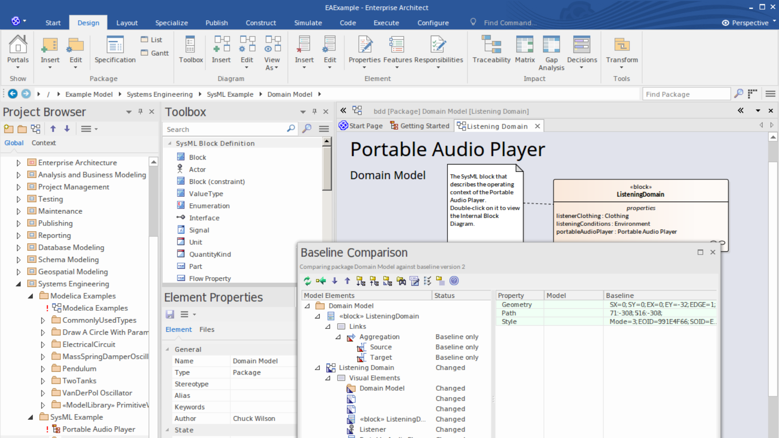
Model Repository
Notes:
An Enterprise Architect repository is stored in a relational database; this can be a file based database such as MS Access or Firebird, or a database management system (DBMS) such as Oracle or MS SQL Server, on a network or in a Cloud Based Repository.
It is common to start with a File Based Repository and, when the project gets some momentum and there are a number of modelers accessing the repository, to transfer it to a DBMS.
Whichever type of repository is implemented, the user interface remains the same and users can seamlessly move from one type of repository to another and continue to contribute as a team member on this powerful modeling platform.
A Model is a related group of content that expresses some focused aspect of a system or enterprise that is related by the modeling tools and paradigm used.
For example, you might build a 'Usecase Model' that describes behavior and scenarios using UML Use Cases. Process models, architectural models, behavioral models, structural models, Class models and so on are all Models within the current Project.
A Project is a group of models that has a single unifying purpose. For example, a Project to design the navigation systems for a new aircraft or automobile would be considered a single Project.
Within this Project there would be multiple models. Projects typically define levels of security, necessary types of views and models, necessary procedures and other management tasks to deliver the product. Project management capabilities in Enterprise Architect are quite rich and allow for resource management, security, change management, testing and other typical project management tasks.
A Repository is a single File, DBMS database or Cloud Server address that contains one or more Projects. Typically, file based repositories such as MS JET and Firebird models contain a single Project with multiple models that can be shared by a small workgroup or only accessed by a single modeler. DBMS and Cloud based Repositories will often contain more than one Project, especially where the Projects are in some way inter-related or co-dependent.

Slide 44
Customizing the workspace
Views and their use
Supplied workspace layouts
Creating your own workspace layout
Notes:
As you perform work on your model, you open various windows, diagrams and views, and you will probably need to return to these same views in a later work session. At the end of your work session, you can capture your current work environment as a working set, which you use to return to that exact environment later, either when you choose to or by having the system automatically recreate it when you next log on to Enterprise Architect. You can also create a working set as an empty definition to which you add specific windows, diagrams and views, from either the 'Working Sets' tab or from a Working Set Artifact element.
You can use the working set to pick up your work from where you left off, or as a set of 'home pages' to start from each day. You can also open multiple working sets, which combines the views from each set. This can be useful to check the progression between different stages in a piece of work.
A working set is initially a personal list, not visible to or active for any other user. You can convert it into a global set to share with other users of your model; for example, if a working set shows a cross-section of an aspect of the model you want to demonstrate or have reviewed.
Access

Slide 45
Creating and managing models
Creating diagrams
Diagram properties
Creating elements
Element properties including tagged values and linked documents
Overview of Model Driven Generator Technology (MDG) for creating customized modelling elements

Slide 46
Share Enterprise Architect Projects (file repos)
Network deployment
Replication
XMI Import and Export
Notes:
Replication enables data interchange between .EAP based repositories and is suitable for where many different users work independently in parallel development.
Modelers merge their changes into a Design Master only as required; it is recommended that a backup is carried out prior to replication.
Replication cannot be performed on repositories stored on a DBMS server.
Convert the base project to a design master.
Create replicas from the design master.
Take the replica away and work on it as required, then bring it back for synchronization with the design master.
Synchronize the replicas, during which all changes to both the master and the replica are propagated in both directions, so they both finally contain the same information.
Configure > Model > Integrity Check > Manage .EAPX/.EAP File > Make Design Master
XMI Import/Export can be used to export and share discrete Packages between developers; XMI enables the export of Packages into XML files that can then be imported into any model.
Package control can be used to set up Packages for Version Control and to enable batch export of Packages using XMI; Version Control enables a repository to be maintained by a third-party source code control application that is used to control access and record revisions.

Slide 47
Repository structure
Roots, views and packages
Best practices for repository structure
Resources

Slide 48
SECURITY

Slide 49
Security
User security is not automatically enabled on the system
Security Administrator can enable using an authorization key obtained from the Sparx Systems website
{C27378C8-6CD8-4efa-92F8-4E0E4F1A8B65}
„Automatically apply Exclusive Edit Locks to diagrams”
Configure > Security > Administer > Enable Security
Notes:
If required, select the 'Automatically apply Exclusive Edit Locks to diagrams' checkbox.
In standard (User/Group Locking) mode, this option blocks multiple users from simultaneously attempting to modify the same diagram (see Notes).
This option is ignored in 'Require User Lock to Edit' security mode.

Slide 50
Security Policy
The security policy determines how security mechanisms are applied and interpreted on the system
User/Group Locking mode
Require User Lock to Edit mode
https://sparxsystems.com/enterprise_architect_user_guide/14.0/team_support/permissionlist.html
Notes:
User/Group Locking mode - All elements and diagrams are considered unlocked and anyone can edit any part of the model; however, when you edit a diagram, Package or element, you lock the element or set of elements at either the user level or group level and no other user can edit the object This mode is good for cooperative work groups where there is a solid understanding of who is working on which part of the model, and locking is used mainly to prevent further changes or to limit who has write access to a part of the model
Require User Lock to Edit mode - More rigorous: the model is read-only, and everything is locked so that nobody can edit anything unless they explicitly check out the object with a user lock; a single 'check out' function operates on a diagram to check out the diagram and all contained elements in one go. There are also functions on the context (right-click) menus of Packages, diagrams and elements in the Project Browser to apply a user lock when this mode is in use You would use this mode when there is a strict requirement to ensure only one person can edit a resource at one time; this is suitable for much larger projects where there might be less communication between users
Only the Admin Security Administrator, with Admin permissions, is able to set the security policy applied
When you add new elements in 'User/Group Locking' mode (elements editable by default), no user lock is created automatically for the newly created element
When you add new elements in 'Require User Lock to Edit' mode (elements locked by default), a user lock is created on the new element to enable instant editing

Slide 51
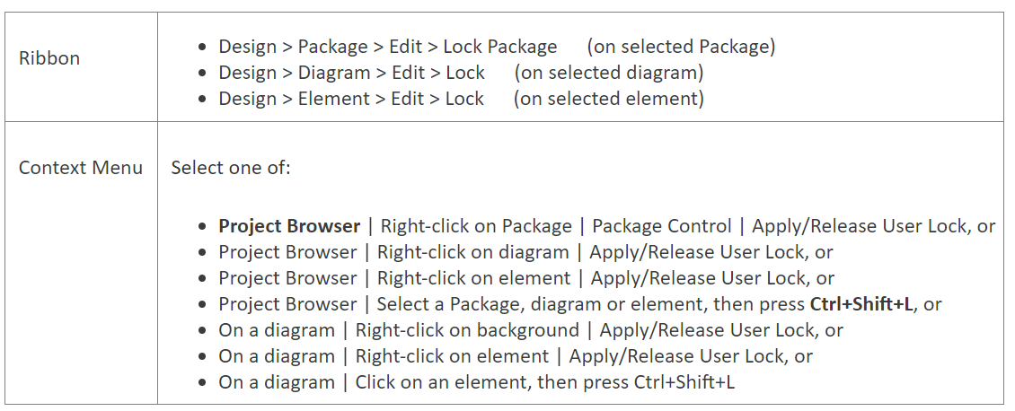
Manage locks

Slide 52
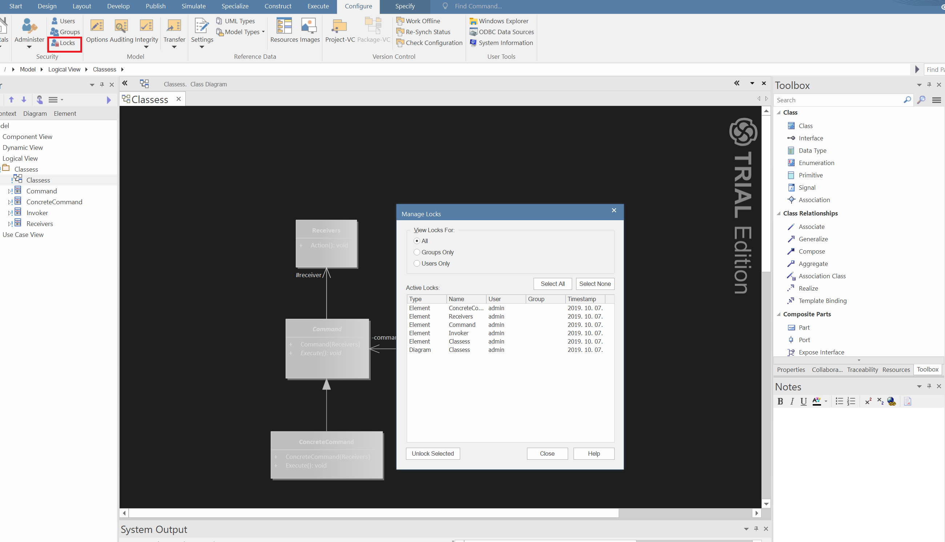
View locks
Notes:
Once you have set a lock, only you or the Security Administrator can release it again; no other user can release your locks.
CTRL SHIFT L

Slide 53
COLLABORATION

Slide 54
Working Collaboratively
Enterprise Architect has been built from the ground up as a team modeling platform
The team support includes features
Baselines
Version-control
discussion Forum, team Library
Gantt Charts
role-based security system
Notes:
The team support includes features ranging from Baselines, Version Control and a Reusable Asset Service that protect the valuable modeling assets in a team environment, to collaborative tools such as a Discussion Forum, Team Library and Gantt Charts to facilitate people working together. The role-based security system has been designed to encourage collaboration, allowing team members to work together without the fear of interfering with each other’s work
If the project team members require a forum in which to discuss the development and progress of the project, they can make use of the facilities of the Enterprise Architect Team Library. Ctrl+Alt+U

Slide 55
Team library
Select to display and edit an item in the 'Team Document' tab, by clicking on the item name in the Team Library window
Search for text strings in the item titles to locate Documents on a specific subject, using the 'Search' icon in the toolbar of the Team Library window
Add resources to a Category, Topic or Document, such as diagram images and XMI files of Packages; these are held in a Resources folder under the selected Team Library item
Link model elements, diagrams, external files and other Documents to a Document
Link to a Team Library Document from the Linked Document on an element
Change the loading behavior of the Team Library
Access Team Libraries from other projects, including those on other servers

Slide 56
Model Driven Generation
MDG Technologies allow users to extend Enterprise Architect's modeling capabilities to specific domains and notation
MDG Technologies seamlessly plug into Enterprise Architect to provide additional toolboxes, UML profiles, patterns, templates and other modeling resources
https://sparxsystems.com.au/resources/mdg_tech/
Notes:
An MDG Technology is a vehicle for providing access to the resources of either a commercially-available technology or a technology that you have created yourself. Such resources include a wide range of facilities and tools, such as UML Profiles, code modules, scripts, Patterns, images, Tagged Value Types, report templates, Linked Document templates and Toolbox pages.
Using Enterprise Architect, you can develop models based on the standard UML specifications, and you can extend the core UML structures using UML-supported mechanisms such as Tagged Values, Stereotypes, Profiles and Design Patterns. These facilities are within the Enterprise Architect core technologies, and you can activate and use further Model Driven Generation (MDG) Technologies that are either integrated with the system or available from external locations.

Slide 57
DOCUMENT GENERATION

Slide 58

Thank you
atbalog@microsoft.com

